Slide 1
PCCA SENIOR NIGHT
August 25, 2022
Slides will be posted on the PCCA Website

Slide 2
PCCA/GIBBS SENIOR DUES (Green Sheet)
Must pay Gibbs High School Senior Dues First!
Due NOW!
Payment Link: pcsb.revtrak.net
Gibbs High School Senior Dues: $120
PCCA Senior Dues: $100*
*If you do not pay during semester 1, dues will increase to $120 semester 2

Slide 3
Introduction: MRS. MARZI
College: University of Connecticut

Slide 4
AGENDA
Transcripts/Graduation Status
Month by Month Planning
Applying to Colleges
Paying For College

Slide 5
Q&A
If you have any questions, please complete the Form and I will answer by email or phone
https://forms.office.com/r/HYKB3ZhhfS
Deadline: Friday, September 2nd

Slide 6
Graduation requirements overview
4 Credits of English
4 Credits of Math
Must include Algebra and Geometry
3 Credits of Science
Must include Biology
3 Credits of Social Studies
Must include World History, US History, US Government (half credit), and Economics (half credit)
1 Credit of HOPE (Physical Education)
Waiver Eligibility (Purple Handout)
1. playing a JV or varsity sport for two years
2. 1 year of dance/band course AND Personal Fitness course
College Admissions Requirements: 2 Years Foreign Language

Slide 7
High School Graduation- Other Requirements
2.0 overall GPA
Testing Requirements
Score of 3 or better on FSA Reading (10th grade year or after)
Score of 3 or better on Algebra EOC
Must take and pass an online course through PVS/FLVS
**Economics/Government honors also completes this requirement
Concordant Scores

Slide 8
Concordant scores

Slide 9
Transcripts: What classes do I need to graduate?
Last page→ CREDIT SUMMARY→ DEFICIT Column
Do NOT worry about the deficits in the elective row
Deficits: courses/credits needed to graduate

Slide 10
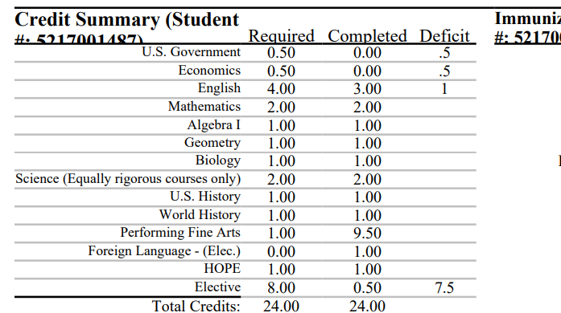
Transcripts Continued
Make sure your are scheduled into a course that will complete the deficit column

Slide 11
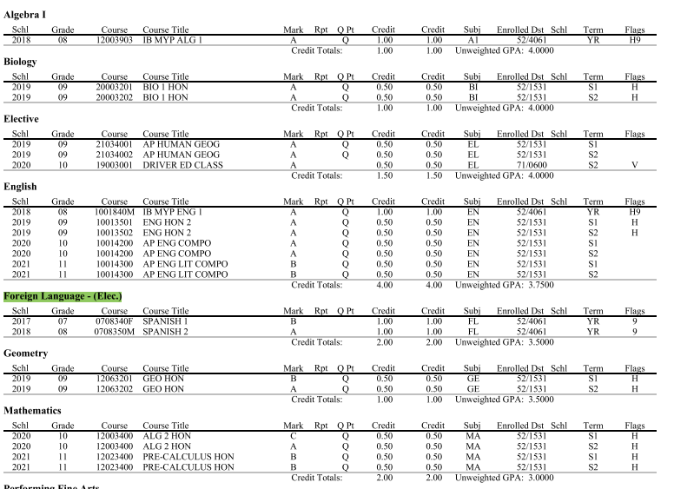
Transcripts Concluded
Double Check:
Minimum 2 years of the SAME language, taken sequentially required for colleges
Notes:
For junior presentation, add the FSU Screenshot.

Slide 12
AM I ON TRACK?
GREEN STICKER: ON TRACK TO GRADUATE
- Testing requirements complete
- Need to pass current classes to remain on track
RED STICKER: OFF TRACK
- wrote notes for what is needed (testing, credit recovery for failed core classes or GPA)

Slide 13
Florida Virtual Reminders
Any course taken through FLVS to meet a graduation requirement MUST be completed by January 14. Parent approval will be needed to continue a graduation requirement course through FLVS.
For example, if you are taking US Government and Economics through FLVS, BOTH must be completed by January 14th. If not, I will enroll you in a class face to face OR need parent permission to continue.

Slide 14
Monthly planning
Slides will be posted on the PCCA Website
Hyperlinks embedded for easier navigation at home!

Slide 15
AUGUST/SEPTEMBER
Attend Senior Night to receive graduation checklists
SAT/ACT Testing: Be sure that you have taken the College Board entrance exams. See Mrs. Lindhardt to check eligibility and access fee waivers.
Letters of Recommendation: Ask teachers and counselor two weeks in advance. Provide resume when you ask.
Update your resume-update summer work and new/continued activities
Finalize college list, essay and begin applying!
Double-check Gibbs graduation requirements as well as academic requirements of those colleges to which you are applying.
Example: On the NYU website, they state they would like to see 3-4 science credits and the TOP APPLICANTS complete the maximum
Notes:
Make sure the schools you are applying to NEED letters of rec. Some schools doing away with them

Slide 16
OCTOBER/NOVEMBER
FAFSA (Free Application for Federal Student Aid): Applications open on October 1st. Apply at here!
Every senior should complete
FAFSA Night at Gibbs: TBD
FFAA (Florida Financial Aid Application) opens October 1.
- Must be completed to be eligible for Bright Futures. Complete by April 1.
Begin researching scholarship opportunities
APPLY, APPLY, APPLY!
Notes:
Some schools require FAFSA to be completed to be considered for school scholarships

Slide 17
DECEMBER/JANUARY
MOST Applications should be complete
Complete and submit your community service hours by January of your graduating year.
Florida Virtual School Grades due for graduation requirements
Make any necessary schedule changes for graduation requirements ONLY
Request Mid-year transcript/report in Naviance by January 31st

Slide 18
February/March
Communicate with financial aid personnel at your selected colleges/institutions with any questions about financial aid awards.
Maintain second semester grades. Colleges CAN withdraw acceptances if grades decline.

Slide 19
April/May
Inform college of your decision to attend and pay any deposits.
Request FINAL transcripts in Naviance for your college
Remember to request/send dual enrollment transcripts
Requested through SPC

Slide 20
APPLYING TO COLLEGE

Slide 21
It's important to stay organized as you work on your applications.
Each college needs you to complete common questions (personal information). Beyond that their applications vary. Each college can determine their unique requirements for:
Deadlines
Application Fees
Personal Essay
Courses & Grades
Test Policy
Portfolio
Writing Supplements
Recommendations

Slide 22
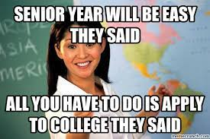
Where to begin
Find out HOW to apply to the college
Common Application-Most popular. Fill out personal information once and supplemental information for each college.
Institutional Application-apply through institution
Organize/track application requirements and deadlines!
**Common Application is the most popular way to apply to schools

Slide 23
Types of Deadlines
Regular Decision
Most common, typically between November and January
Early Decision
Most restrictive, MUST attend if accepted, typically between October and November. Use with caution. Binding.
Early Action
Nonbinding, considered for placement before regular decision applications. Do NOT have to commit if accepted
Rolling
Colleges decides/accepts students as they receive applications
Priority
If a college lists priority, your best chance of acceptance is to apply by this deadline
Notes:
Early Decision—absolute dream school AND ensure you can afford it BEFORE you see the financial aid.

Slide 24
College Applications Steps
Register with and Create a Common App Account at CommonApp.org
On Common App:
Add High School Information
Add at least one college
Review and Accept FERPA Release Authorization
Match your Common App account to Naviance
Add any non-Common App colleges to Naviance “Colleges I’m Applying To” list
Select application method and deadline for all non-Common App colleges
Request materials for ALL college applications in Naviance
Transcripts
Letters of Recommendation
**Video instructions on next slides

Slide 25
Naviance
Request transcripts, letters of recommendation
Students can view how a college accepts applications
Share with counselors what colleges you are applying to
Allows counselor to track and send transcripts, letters of recommendation and other school document
Access Naviance through Clever

Slide 26
The basics: USING COMMON APP AND NAVIANCE
Matching Common App and Naviance:
Most schools can be applied through Common Application and that will be our focus https://www.screencast.com/t/wJlv73VNdeA
Requesting Transcripts:
https://www.screencast.com/t/LMtSIif3e1
Notes:
Requesting Transcripts: From Colleges I am Applying to

Slide 27
Adding colleges that are not common app
https://www.screencast.com/t/jp4DehOsrA
Notes:
Watch on your own.

Slide 28
Request Letters of Recommendation
Go to Colleges > Letters of Recommendation
Select Add Request on top right
Select a Teacher
Select which colleges the request is for
Include a personal note
Select Submit Request

Slide 29
Track submission status in naviance
Go to Colleges I’m Applying To List
Check the Transcript column to review when a counselor has submitted a transcript
The transcript column will say ‘sent’ if the transcript has been sent
Check the Office Materials column to review when a staff member has indicated that all materials have been sent for that application.
The Office Materials column will say ‘submitted’ if transcripts and any other required materials, like Common App forms or other school-specific forms, have been sent

Slide 30
Tracking letters of Recommendation
Go to Colleges
Select Letters of Recommendation
Check the Status column to review when a teacher has submitted a LOR

Slide 31
Naviance Student Videos
Notes:
Embed this into the website.

Slide 32
Paying for college

Slide 33
FAFSA
Every high school senior should fill out a FAFSA.
FAFSA provides access to:
Pell Grant – free money
Work Study
Student Loans at best terms
Required for some College Scholarships & Aid
Application opens Oct. 1 each year.
https://studentaid.gov/understand-aid/types
Fill the FAFSA out as early as possible to get the most aid.
Gibbs FAFSA Completion Night: TBD

Slide 34
Scholarship Resources
Florida Financial Aid Application – by Apr 1
Pinellas Education Foundation – by Jan 15
PCSB Scholarship Matrix
Naviance Scholarships List
Big Future/College Board
Opportunity Scholarships – earn entries with completion
Scholarship Search Sites
FASTWEB.com
Scholarships.com
Scholarships360.org – follow on twitter for daily highlights
Employers & Membership Organizations

Slide 35
Florida Bright Futures Scholarships
(YELLOW HANDOUT)
Awarded to every student in the state of Florida who meets the eligibility requirements.
FAS- 100% tuition & fees at a public institution
Non-public institution will receive a comparable amount
FMS- 75% of tuition & fees at a public institution
Non-public institution will receive a comparable amount
Must complete the FFAA

Slide 36
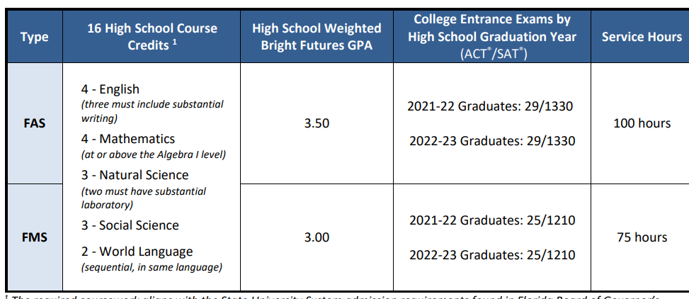
Florida Bright Futures Scholarships
Eligibility for Academic and Medallion Level Scholarships

Slide 37
What you need to turn into Mrs. Marzi (White handouts)
1. Bright Futures Community Service Proposal Form
2. Bright Futures Community Service Log and Reflection Form

Slide 38
UPCOMING DATES/NEXT STEPS
SPC Free Application Drive: 10/24 11:30-2
SAT TEST- Saturday, October 1
Registration Deadline: September 2
ACT TEST – Saturday, October 22
Registration Deadline: September 16
By Monday: Your common App and Naviance Accounts should be Matched
Begin Requesting Transcripts

Slide 39
College & Career Center
Mrs. Oglesby
Monday-Friday
Pink Sheet

Slide 40
HOW TO CONTACT MRS. MARZI (Blue Sheet)
1. Email: marzik@pcsb.org​
​
2. Google Text Number: 813-530-8133 (TEXT ONLY) ​
- Available during school hours ​
- Not used for crisis situations ​
​
​
3. Office Phone: 727-893-5452 ext. 2063

Slide 41
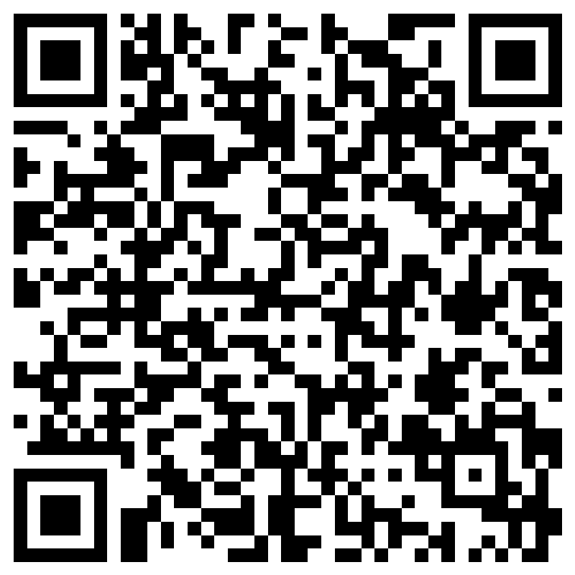
QUESTIONS?

